Slide 1

Internship Presentation
VERZEO
ADITHYA HOLLA K
4NM19CS007
Internship Guide: Ms. Joylin Priya Pinto
Department of Computer Science Engineering NMAMIT Nitte
26/05/2023
1

Slide 2
Flow of the Presentation
Introduction to the Industry
Certificate Awarded
Project 1: Calculator App
Project 2: Candidate Profile App
Project 3: Quiz App
Conclusion
Dept. of Computer Science Eng. NMAMIT
2

Slide 3
Introduction to Company Profile
Verzeo was created in 2018 by CEO V.V Subrahmanyam.
Verzeo assists thousands of students in determining their occupations.
They claim that Verzeo is the one-stop online learning platform that provides students
with all of the resources they need to be prepared for the job.
They want to spread the motto "Everything Learning
Dept. of Computer Science Eng. NMAMIT
3

Slide 4
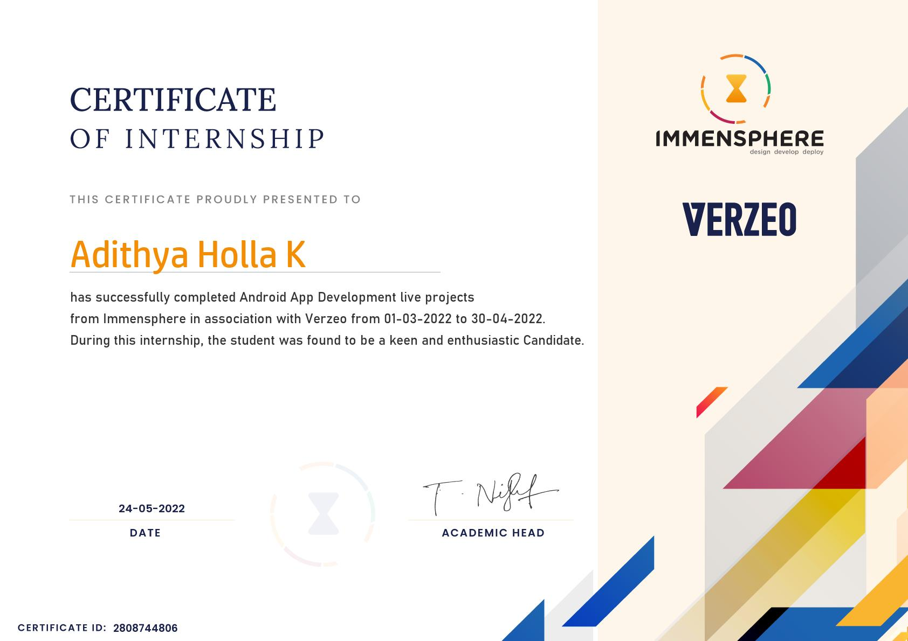
Certificate Awarded
Dept. of Computer Science Eng. NMAMIT
4

Slide 5
Project 1: Calculator App
Problem Statement: Now days are kids or students are slowly in calculations . So we found a basic solutions that is simple calculator where kids can add , sub , multiply , divide
Implementation:
Training started with learning of basics. To get familiar with buttons and programming of UI elements.
A simple calculator app was developed. it mainly consisted of buttons representing different numbers and operators.
Linear layout was used to arrange the buttons and the screen while switch cases were used to switch between different operators.
Result:
The kids can save their time and become are efficient in calculations
Dept. of Computer Science Eng. NMAMIT
5

Slide 6
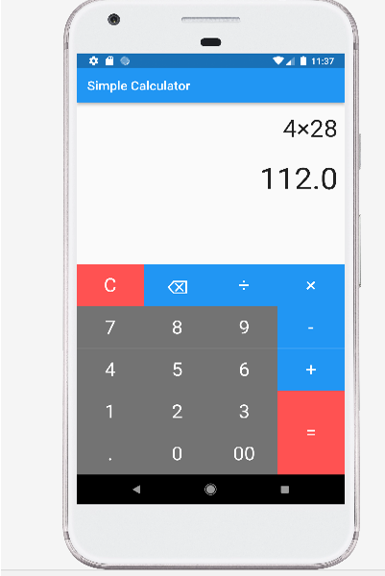
Project 1: CALCULATOR APP
Figure 1 – Calculator App
Dept. of Computer Science Eng. NMAMIT
6

Slide 7
Project 2: Candidate Profile App
Problem Statement: Nowadays selection of employee is very tough because of their skills and other criteria. In order to select best profile our company gave an task to build an app which contain education , personal , skills. So that it is very useful to select best employee for certain job.
Implementation:
We create a profile app that allows users to view specific personal details.
The navigator's push mechanism is used for this navigation.
By using the navigator pop approach, the user can return to the home page from any of the screens.
The user moves from the home screen to the introduction screen when they click the introduction button.
Result:
From this recruiter can select good candidate based on his skills and others criteria and can be selected to specific role.
Dept. of Computer Science Eng. NMAMIT
7

Slide 8
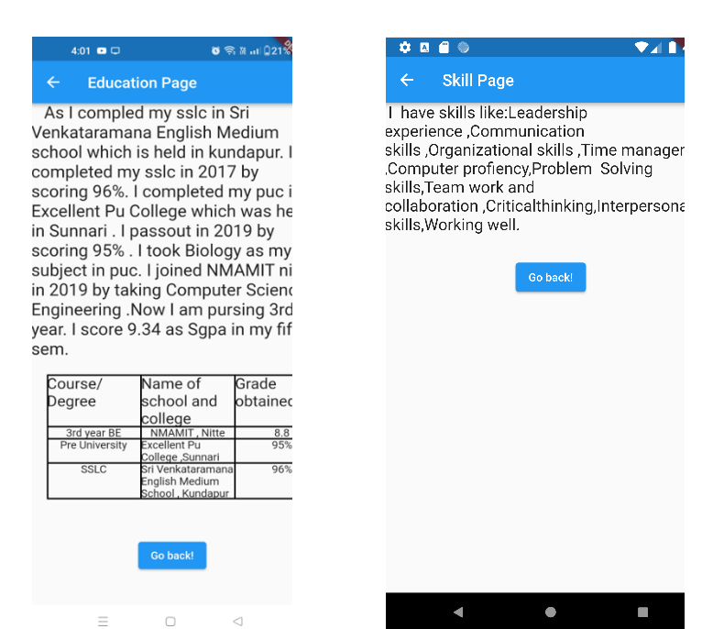
Project 2: Candidate Profile App
Dept. of Computer Science Eng. NMAMIT
8

Slide 9
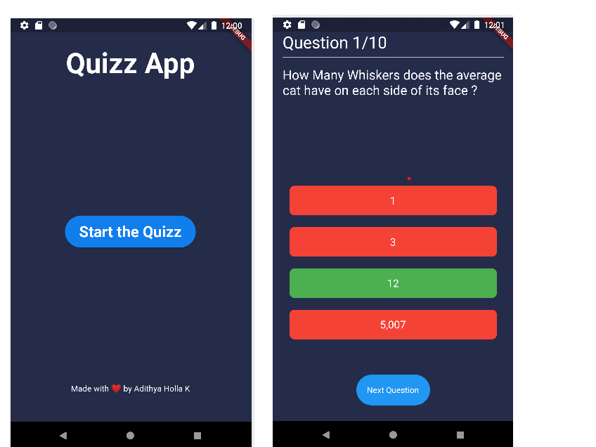
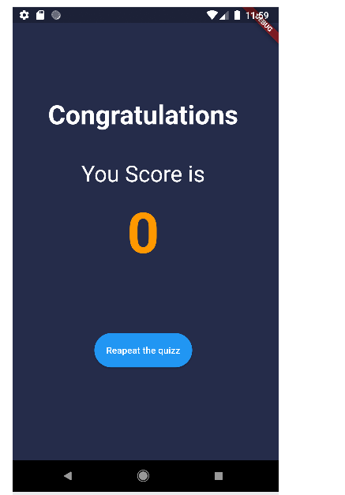
Project 3: QUIZ APP
Dept. of Computer Science Eng. NMAMIT
9

Slide 10
Conclusion
The industrial training experience was valuable and educational, providing an opportunity to learn about various technologies and the processes involved in building strong smart systems and softwares’.
It allowed for the application of knowledge in real-world situations, leading to the development of skills and a comprehensive understanding of Software Development and Deep Learning Operations.
Overall, the experience provided practical knowledge and skills that will be invaluable in future career endeavors.
Dept. of Computer Science Eng. NMAMIT
10

Slide 11
Thank You.
Dept. of Computer Science Eng. NMAMIT
11

